Slide 1
RUNGTA COLLEGE OF DENTAL SCIENCES & RESEARCH
TITLE OF THE TOPIC-
INTERCEPTIVE ORTHODONTICS
DEPARTMENT OF ORTHODONTICS AND DENTOFACIAL ORTHOPAEDICS

Slide 2
Specific learning Objectives
CORE AREAS | DOMAIN | CATEGORY
DEFINITION & PROCEDURES | AFFECTIVE | DESIRE TO KNOW
SERIAL EXTRACTION | PSYCOMOTOR | MUST KNOW
INTERCEPTION OF HABITS | COGNITIVE | MUST KNOW
SPACE REGAINING | PSYCOMOTOR | MUST KNOW
MUSCLE EXERCISES | PSYCOMOTOR | MUST KNOW

Slide 3
CONTENTS
PART I
•INTRODUCTION
•DEFINITION & PROCEDURES
•SERIAL EXTRACTION: History, Rationale, Indications, Contraindications. Advantages,
Disadvantages, Diagnostic Procedures, Procedures in Serial
Extraction.
~ Dewel’s Method
~ Tweed’s Method
~ Nance’s Method
PART II
• INTERCEPTION OF HABITS : Thumb Sucking
Tongue thrusting
Mouth breathing
• SPACE REGAINING
• MUSCLE EXERCISES : For lip, For masseter, For circumoral musculature

Slide 4
INTERCEPTION OF HABITS
Habits in order to orthodontic sense refer to certain actions involving the teeth and other oral or perioral structures, which are repeated often enough by some patients to have a profound and deleterious effect on the positions of teeth and occlusion. Some of the habits that can affect the oral structures are :
Thumb sucking
Tongue thrusting
Mouth breathing

Slide 5
Thumb sucking
One of the habits that is most frequently practiced by children and is capable of producing damaging effects on the dento-alveolar structures is the thumb sucking habit. The presence of this habit upto 2½ - 3 years of age is considered quite normal. Persistence of this habit beyond 3½ - 4 years of age can have a damaging influence on the dento-alveolar structures and should be intercepted. Thumb sucking is intercepted by use of habit breakers that could be of removable type or one that is fixed.

Slide 9
Tongue thrust: Tongue thrust is defined as a condition in which the tongue makes contact with any teeth anterior to the molars during swallowing. This is a deleterious habit that can clinically present with open bite and anterior proclination.
The tongue thrust habit should be intercepted by using habit breakers . The patient should be trained and educated on the correct technique of swallowing.

Slide 12
Mouth breathing: Mouth breathing habit has a profound effect on the dento-facial region. It can be obstructive or habitual in nature. Obstructive mouth breathing is usually a result of nasal obstruction such as nasal polyps , nasal tumors, chronic nasal inflammatory conditions and deviated nasal septum. Habitual mouth breathing is one where oral breathing persists as a habit after the removal of the nasal obstructions.

Slide 13
Mouth breathing affects the oro-facial equilibrium due to lowered mandibular and tongue posture and can therefore produce severe malocclusion.
Interceptive procedures should involve identification and removal of the cause. Persistence of habitual oral breathing is an indication to use a vestibular screen to intercept the habit.

Slide 16
Space regaining
If a primary molar is lost early and space maintainers are not used, a reduction in arch length by mesial movement of the first molar can be expected. In such patients, the space lost by mesial movement of molar can be regained by distal movement of the first molar.
Not all the patients who have lost arch length by mesial molar movement are the ideal candidates for space regaining.

Slide 17
The space regaining procedures are preferably undertaken at an early age prior to the eruption of the second molar. The following are some of the commonly used space regainers.
Gerber space regainer
Space regainers using jack screws
Space regaining using cantilever spring

Slide 18
Gerber space regainer
A seamless orthodontic band or a crown is selected for the tooth to be distalized. This space regainer consists of a ‘U’ shaped hollow tubing and a ’U’ shaped rod that enters the tubing. The tube is soldered or welded on the mesial aspect of the first molar to be move distally. ` the ‘U’ shaped wire or rod is fitted into the tube, in such a way that the base of ‘U’ rod contacts the tooth mesial to the edentulous area. Open coil springs of adequate length are placed around the free ends of ‘U’ shaped rod and inserted into the tubing assembly. The forces generated by the compressed open coil springs bring about a distal movement of the first molar.

Slide 20
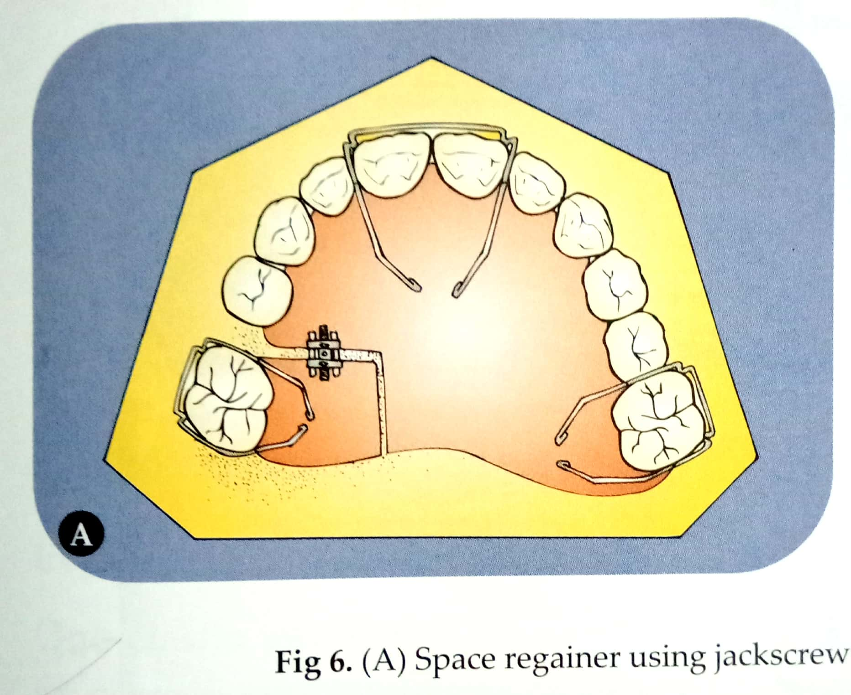
Space regainers using jack screws
Space regaining can be brought about using jackscrews placed in such a way that an increase in arch length is obtained by distalization of molar. The appliance consists of a split acrylic plate with a jackscrew in relation to the edentulous space and is retained using Adams clasps.

Slide 21
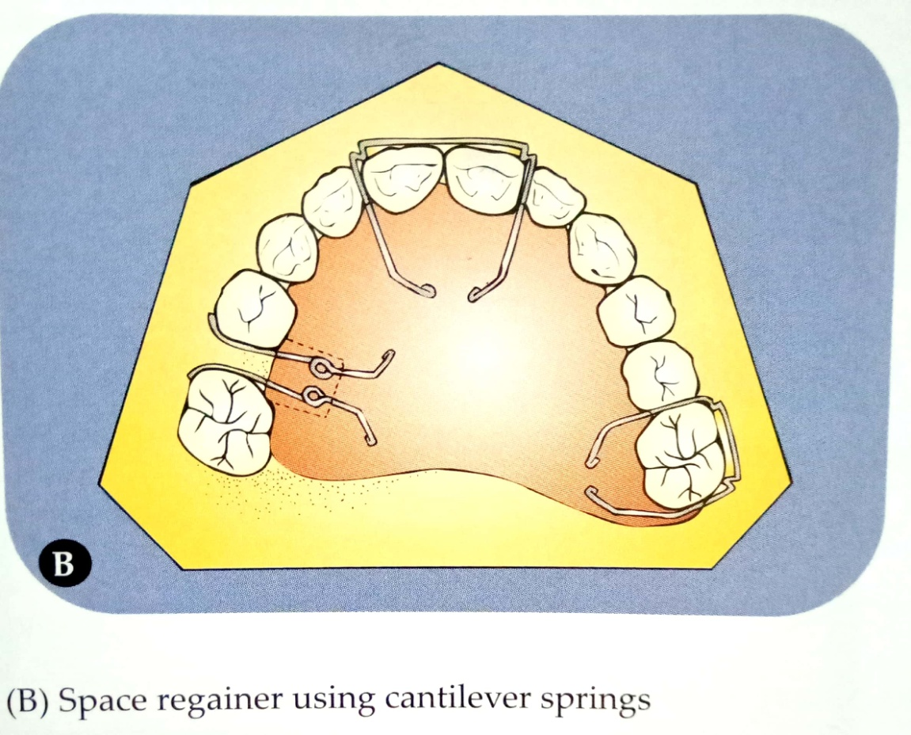
Space regaining using cantilever spring
The molar can be distalized to regain space by using removable appliances that incorporate simple finger springs.

Slide 22
MUSCLE EXERCISES
The dental tissues are blanketed from all directions by muscles. Normal occlusal development depends upon the presence of normal oro-facial muscle function. Muscle exercises help in improving abberent muscle functions.
Exercise for the masseter muscle
An exercise to strengthen the masseter muscle involves the clenching of teeth by the patient while counting to ten. The patient is asked to repeat this for some duration of time.

Slide 24
Exercise for the lip (circum-oral muscles)
A number of exercises have been suggested for the lip and cheek muscles.
Stretching of the upper lip to maintain lip seal is an important therapeutic measure in patients having short hypotonic lips. To aid in the stretching , the patient is asked to hold a piece of paper between the lips.
Patients can be asked to stretch the upper lip in a downward direction towards the chin.
Hold and pumping of water back and forth behind the lips

Slide 25
d. Massaging of the lips.
e. Button pull exercise: A button of 1½ inch diameter is taken and a thread passed through the button hole. The patient is asked to place the button behind the lips and pull the thread, while restricting it from being pulled out by using lip pressure.
f. Tug of war exercise: This is similar to the button pull exercise. This involves use of two buttons, with one placed behind the lips while the other button is held by another person to pull the thread.

Slide 27
Exercises for the tongue
One elastic swallow: This exercise is used for the correction of improper positioning of the tongue. A 5/16 inch intra-oral elastic is placed on the tip of the tongue and the patient is asked to raise the tongue and hold the elastic against the rugae area and swallow.
Tongue hold exercise: A 5/16 inch elastic is positioned over the tongue in a designated spot for a prescribed period of time with the lips closed. The patient is then asked to swallow with elastic in place and lips apart.

Slide 28
Two elastic swallow: Two 5/16 inch elastics are placed over the tongue, one in the midline and the other on the tip and the patient is asked to swallow with the elastics in position.
The hold pull exercise: The tip of the tongue and the mid point are made to contact the palate and the mandible is gradually opened. This exercise help in stretching the lingual frenum.

Slide 30
SUMMARY
The malocclusion may be accepted or be treated in a variety of ways.
The procedures undertaken in interceptive orthodontics include:
1Serial extraction. 2. Space regaining
3. Correction of developing cross bite.
4. Oral habit elimination. 5. Muscle exercises.
6. Interception of developing skeletal malocclusion.
7Removal of soft tissue or bony barrier to enable eruption of teeth.

Slide 31
REFERENCES
Textbook of Orthodontics – Gurkeerat Singh, Jaypee Brothers; 2nd Edition
Orthodontics – The Art and Science, S.I Bhalajhi, AryaMedi Publishing; 7th Edition
Textbook of Orthodontics – Sridhar Premkumar, Elsevier; 1st Edition
Orthodontics: Diagnosis and Management of Malocclusion and Dentofacial Deformities – O.P Kharbanda, Elsevier; 1st Edition

Slide 32
Question & Answer Session

